Slide 1
Your Virtual Closet

Slide 2
Your Virtual Closet
The purpose of our website is to suggest an outfit for you to wear based on what the weather is like wherever you are. Both boys and girls can use this website. You can also register and login to save your favorite outfits to your Personal Closet.

Slide 3
Your Virtual Closet
What we first intended for our project was a bootstrap carousel for all the outfits to be in one place with an animated weather widget and multiple recommendations for each weather.
We wanted to make this project because we know that it’s a struggle to decide what to wear so we made it easier and made it into a website that can be available as another option.
It’s unique because there’s no other website that does this for you.

Slide 4

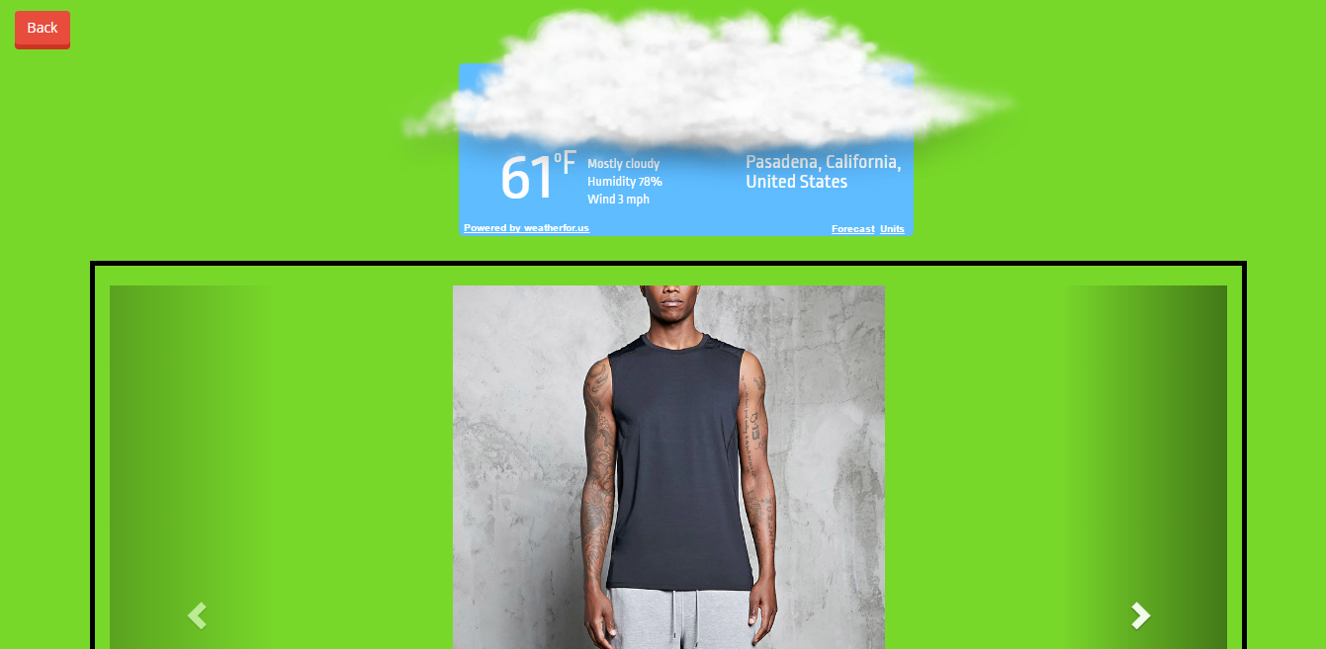

Slide 5
The Software
Our website is made purely with just HTML, CSS and Javascript.
Our new and improved weather widget is a Weather API to get your location and the temperature.
We researched on Google for inspiration for the buttons, the forms and the fonts.
It was mostly made with our knowledge of HTML, CSS and Javascript from the past App Academy classes.

Slide 6
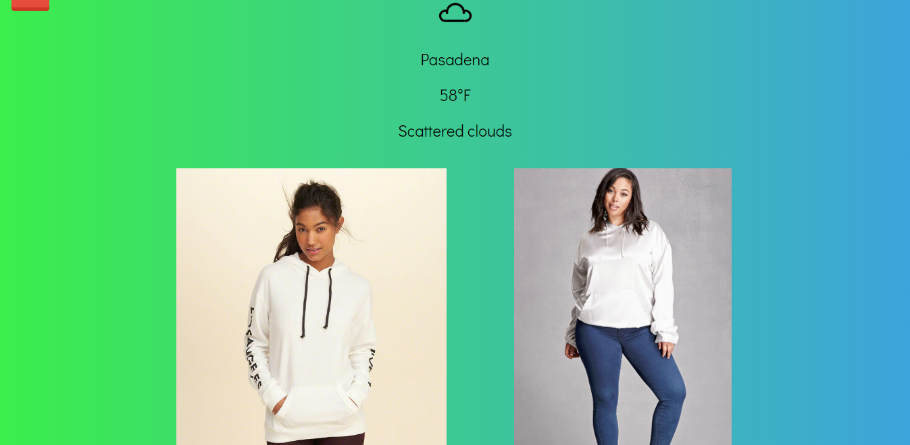
The Software

Slide 7
The Challenges
The hardest thing to do was get the Register and Login to work. With a database and everything. It was very time consuming.
Another struggle we had was to get everything lined up in the center of the website for a clean look. We adjusted the CSS many times and finally got it to the center.

Slide 8
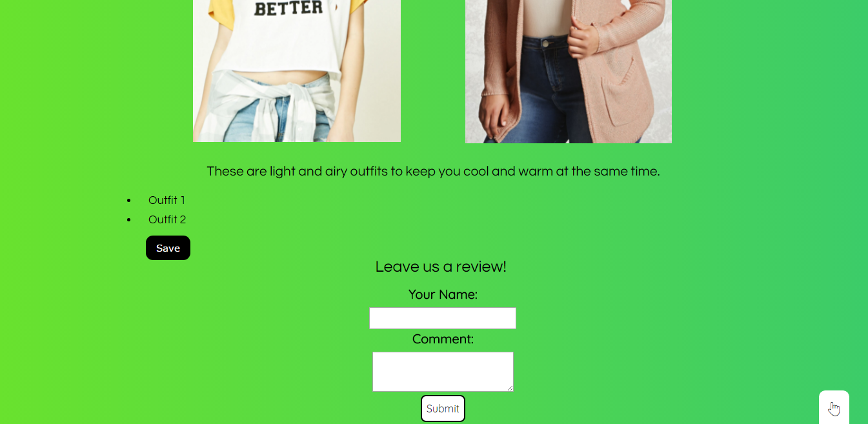
The Challenges

Slide 9
The Final Outcome
Our project gets your location and the weather and automatically suggests two outfits for you that best fit the weather.
There are also descriptions to the outfits and the links for them.
You can leave a review with anything you’d like us to make better.
And you can save any two outfits you like and view them in your Personal Closet after you register and login.

Slide 10
Thanks!
Any questions?

